Slide 1
Modelling the Early Diagnosis of Heart Disease using SPECT Images
Aminu Abdusalam and Adetunji Akinola

Slide 2
Background
A Single Proton Emission Computed Tomography (SPECT) scan of the heart is a noninvasive nuclear imaging test that involves injecting radioactive tracers into the blood to produce pictures of the heart.
Coronary artery disease (CAD) sometimes called ischemic heart disease is the most common type of heart disease in the United States. For some people, the first sign of CAD is a heart attack. SPECT shows how well blood is flowing to the heart and how well the heart is working; thus, doctors use SPECT in early diagnosis of coronary artery disease and find out if a heart attack has occurred.
Using data mining and computerized approaches, cardial perfusion diagnosis can be achieved with SPECT images. In fact, in a previous work by Lukasz Kurgan et al, SPECT images were processed to extract a set of features, and explicit rules were generated using machine learning to mimic a cardiologist[1].

Slide 3
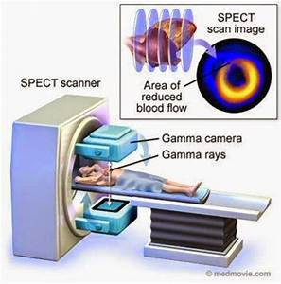
Background
Doctors recommend cardiac SPECT because it show areas of the heart that have low blood flow at rest or during exercise. This information helps the cardiologist find out:
i) if the patient has coronary artery disease
ii) if the patient has had or is at the risk of having a heart attack and areas of scar tissue exist.
iii) how well bypass surgery or other cardiac procedures are working
iv) if the patient has had a heart attack and needs more immediate tests such as a cardiac catheterization or percutaneous coronary intervention (PCI) [2]
Figure 1: SPECT Imaging Procedure

Slide 4
Dataset Information
The dataset describes the diagnosis of cardiac SPECT images and it was accessed from the UCI Machine Learning Repository on October 8, 2020.
The original owners are Krzysztof J. Cios, Lukasz A and Kurgan Lucy from University of Colorado at Denver and S. Goodenday (Medical College of Ohio). and the donors are Lukasz A.Kurgan and Krzysztof J. Cios [3].

Slide 5
Dataset Information
There are 267 instances of patients with each patient having 22 binary independent variables each indicating a partial diagnosis labelled F1 through F22
There is 1 binary dependent variable indicating the OVERALL_DIAGNOSIS received from the SPECT scan (whether the patient is normal or abnormal).
The original dataset is split into 80 instances of training data and 187 testing, so in order to improve the model accuracy the instances were merged and re-split into 75% training and 25% testing data.

Slide 6
Machine Learning Methods and Tools
We developed various models including Logistic Regression, Support Vector Machines and Artificial Neural Networks to simulate the early diagnosis of cardiac disease using SPECT images. During the cresting and testing of the various models we used these Python libraries:
i) Numpy: It was used for data preprocessing. It added support for the large, multi-dimensional arrays and matrices in our model, along with a large collection of high-level mathematical functions to operate on these arrays.
ii) Pandas: It was used for data manipulation and analysis. In particular, it offers data structures and operations which we used for manipulating numerical tables and time series. For instance, it was used in dropping samples/features when processing missing data.
iii) Scikit-Learn: It provided the Estimator API whose transformer classes were used for data preprocessing like fitting and transformation. Also, it features several algorithms which were used in model building and selection, and result analysis.

Slide 7
Results: Support Vector Machine
Kernel | C | Gamma | Degree
Linear | 10 values between 10⁻⁴ and 10¹ | 10 values between 10⁻² and 10²
RBF | 10 values between 10⁻⁴ and 10¹ | 10 values between 10⁻² and 10²
Polynomial | 10 values between 10⁻⁴ and 10¹ | values between 10⁻² and 10² | 2, 3
Cross-Validation is a technique for validating and estimating a model’s performance by training it on the subset of input data and testing on previously unseen subset of the input data.
The five-fold cross-validation method was used to search the best hyper-parameters for the Support Vector Machine model.
Kernels takes data and transforms it into desired form so we tested our data with three different kernels.
These are the Kernels and hyper-parameters combinations are shown in the Table 1
Table 1

Slide 8
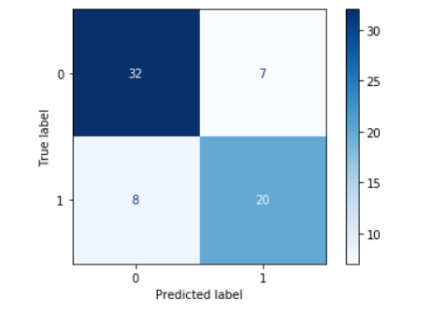
Confusion Matrix: Support Vector Machine

Slide 9
Results: Support Vector Machine
After implementing the Support Vector Machine using three different Kernels, and the hyperparameters C (inverse of regularization strength) and Gamma, the model implemented with the rbf kernel showed the best results. The results are shown in Table 2 below.
Kernel | C | Gamma | Training Score | Test Score
RBF | 1.0 | 0.01 | 74.0% | 76.1%
Table 2

Slide 10
Results: Artificial Neural Network
Score | Alpha | Hidden Layer | Training score | Testing score
Accuracy | 10.0 | (8, 4) | 78% | 71.6%
Precision | 10.0 | (8, 4) | 76.6% | 60.8%
Recall | 1.0 | (4,) | 97.2% | 57.5%
F1 Score | 10.0 | (8, 4) | 76.6% | 60.9%
We also searched the hyperparameters to get the highest precision,recall, and F1 scores. We searched 5 values between 10^-2 and 10^2. The best resulting hyperparameters are:
Figure 3

Slide 11
Results: Logistic Regression
We also searched the hyperparameters to get the highest precision,recall, and F1 scores. We searched 9 values between 10^-4 and 10^4. Here are the C values and best results we get:
Score | C value that generates the best score | Training score | Testing score
Accuracy | 0.1 | 81.0% | 78.1%
Precision | 0.01 | 82.6% | 72.7%
Recall | 1.0 | 69.0% | 68.1%
F1 Score | 1.0 | 70.3% | 62.2%

Slide 12
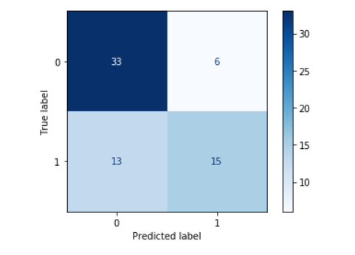
Confusion Matrix: Logistic Regression

Slide 13
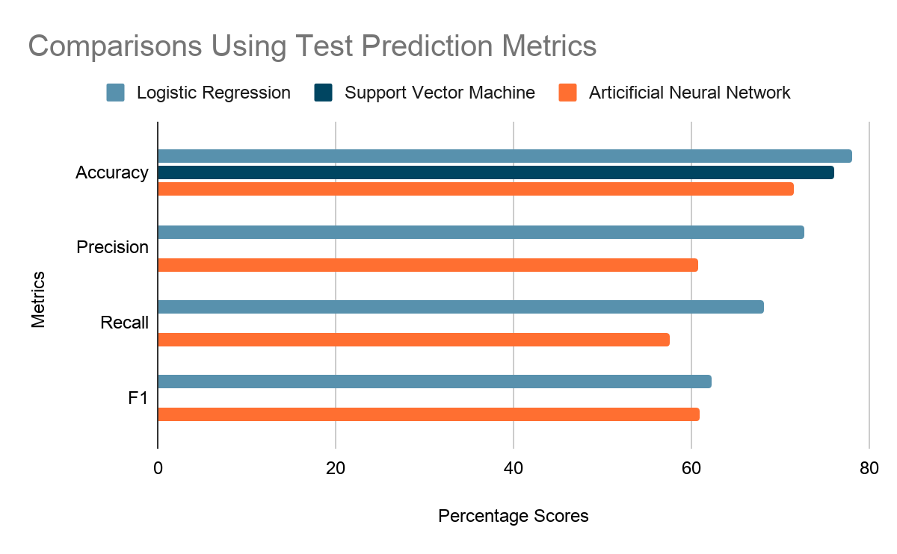

Slide 14
Conclusion
We processed and compared Support Vector Machine (SVM), Logistic Regression and Neural Network Models and the Logistic Regression had the best accuracy and precision of the models we tested.
Although the SVM had slightly better scores for recall and f1. It is not surprising that Logistic Regression had slightly better scores for accuracy and precision than SVM as both are excellent supervised ML Algorithms.
Neural networks are more complex to train and usually more prone to overfitting so it keeps with the trend as to why the Artificial Neural Network has to the lowest score of the three models we used.

Slide 15
Future Work
Given the results we got from this training iteration, the model doesn’t work well and we are looking to improve the efficacy of our model .
One plan we have for future works is spending more time tuning the hyperparameters of our current model.
Another possibility we plan to explore is the use of more ML algorithms such as Decision Trees, K-Nearest Neighbors to help in finding a better solution to our binary classification problem.

Slide 16
References
[1]Kurgan, Lukasz A., et al. “Knowledge Discovery Approach to Automated Cardiac SPECT Diagnosis.” Artificial Intelligence in Medicine, Elsevier, 26 Sept. 2001, www.sciencedirect.com/science/article/pii/S0933365701000823.
[2]www.heart.org. 2020. Single Photon Emission Computed Tomography (SPECT). [online] Available at: https://www.heart.org/en/health-topics/heart-attack/diagnosing-a-heart-attack/single-photon-emission-computed-tomography-spect> [Accessed 6 November 2020].
[3] Krzysztof J. Cios, Lukasz A. Kurgan, Lucy S. Goodenday. (2019). UCI Machine Learning Repository [http://archive.ics.uci.edu/ml]. Denver, CO: University of Colorado at Denver et OH, U.S.A.:Medical College of Ohio,

